Slide 1
Introduction to Machine Learning 2: Adding Background SE G QPI QM P

Slide 2

Training Objective
By the end of this course, you will …
Have an understanding / basic mathematical background of decision tree and neural networks taught in ML1
Be enabled to better interpret Machine Learning results using this background
Know enough about ML to explore other algorithms on your own
Discuss application opportunities of Machine Learning in our business
This training is an experiment
New teaching approach, digging deeper after targeting “everybody”
Focus is not to program it yourself in python
Helpline (Kay)
We are all learning: We don’t have very much experience yet, where Machine Learning is actually improving our business.

Slide 3

How This Training Works
Experiment, we are all learning
ML1 is prerequisite (enough to read through slides)
2x10 Min Break
Recording: high demand, few training seats
Based on interaction
Discussions, Exercises + Debriefs
Harder in Circuit
If I should not call on you, please tell us now

Slide 4
Please Give Us Feedback!
Feedback is very important for us. This course is free, but we need to know if this is beneficial for you.
Based on your feedback, we will continue to offer this, develop additional courses – or not.
Please visit at the end of this course the following website: https://forms.office.com/Pages/ResponsePage.aspx?id=PqlLJW8f80iQ5uJ2ZmS0d-5LdjYRShZEhN3YmsD7St9UMFZZTFFVQjFSUUxTMzhQNTM3S1hSM0ExVS4u

Slide 5

Agenda
Review ML1
Model Evaluation:
Regression Quality Metrics
Classification Quality Metrics
The Bias-Variance Trade-Off
Model Types:
Decision Trees (Ensemble: Random Forrest)
Neural Networks
Basic Steps of Training a Neural Network
Neural Network Exercise
Application of Machine Learning in Our Business

Slide 6
Overview
 | Target values | Loss function | Error metric | Act function last layer (for NN) | Act func hidden layers (For NN)
Regression | Continuous | MSE, R², MAE,… | MSE, R², MAE,… | Linear/ ReLu | ReLu
Classification | Binary | Binary cross entropy | F1 score, precision, recall, ROC-curve | Sigmoid | ReLu
 | multiple classes | categorical cross entropy | F1 score, precision, recall, ROC-curve | Softmax | ReLu
 | Decision Trees | Artificial Neural Nets
Tabular data | Ensemble methods: Random Forest, Boosting | Starting from simple architectures
Text | - | Transformers (encoding, decoding, attention)
Images | - | CNNs

Slide 7

We Are Using EnergyAI as a Tool to Run Machine Learning Algorithms
Please register on EnergyAI before starting the training:(https://energyai.siemens.cloud/)
Request access to “Analyse”
You will find the files in EnergyAI in the folder shared>users>kay.toepfer@siemens.com>Data Science Workshop.
More details how to get to Kay’s folder in the following slides
Request Access

Slide 8

Go to Analyse

Slide 9
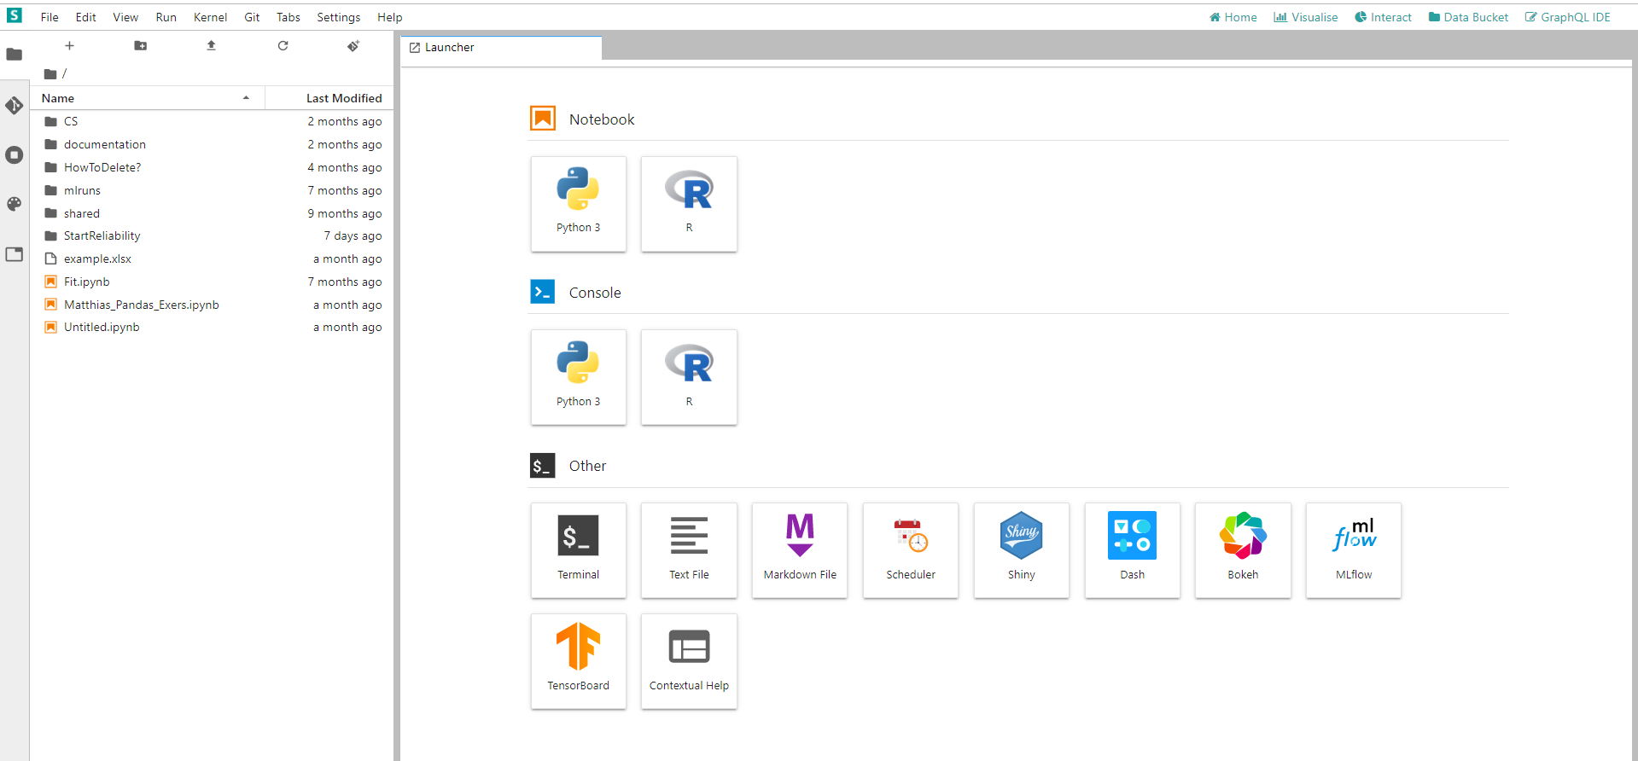
Click on Shared

Slide 10
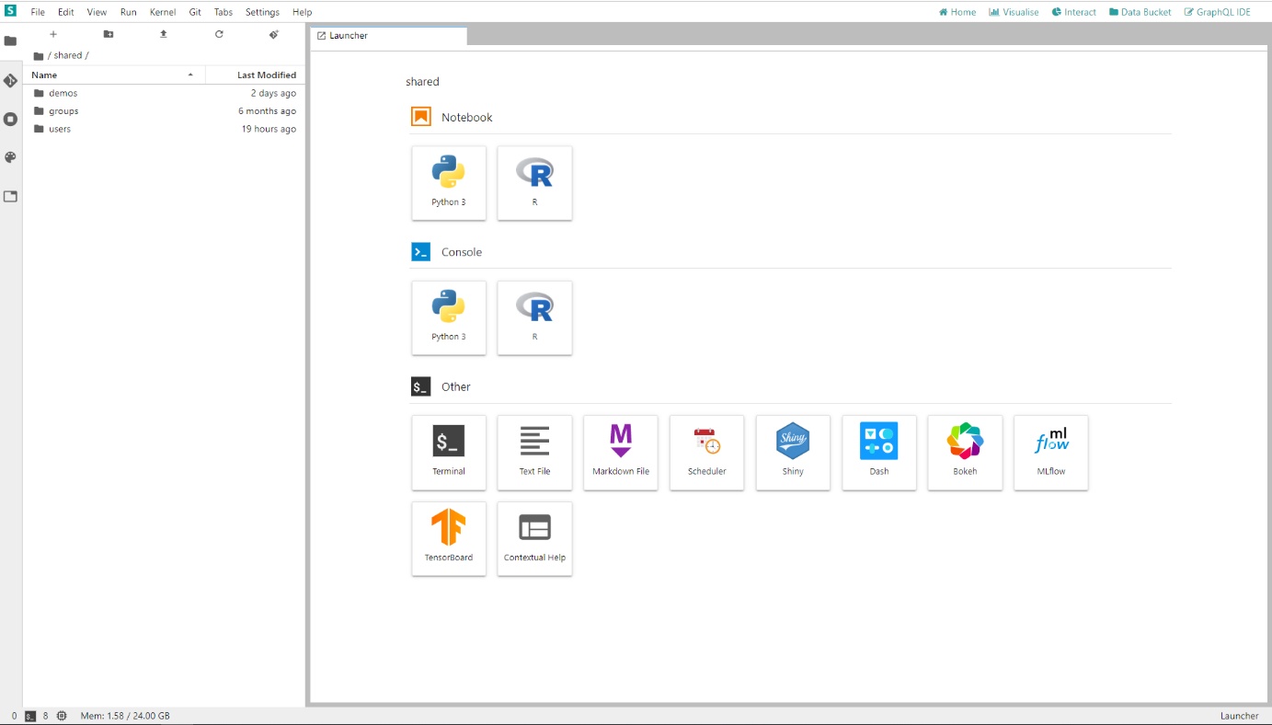
Click on Users

Slide 11
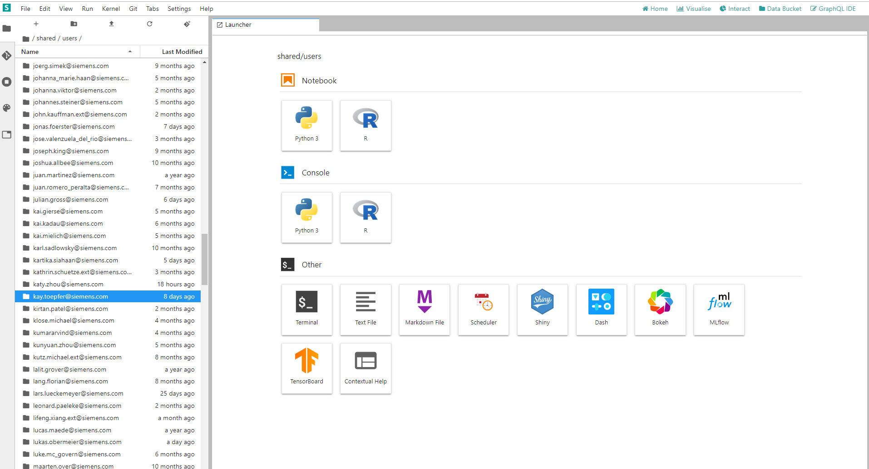
Search for kay.toepfer@siemens.com

Slide 12
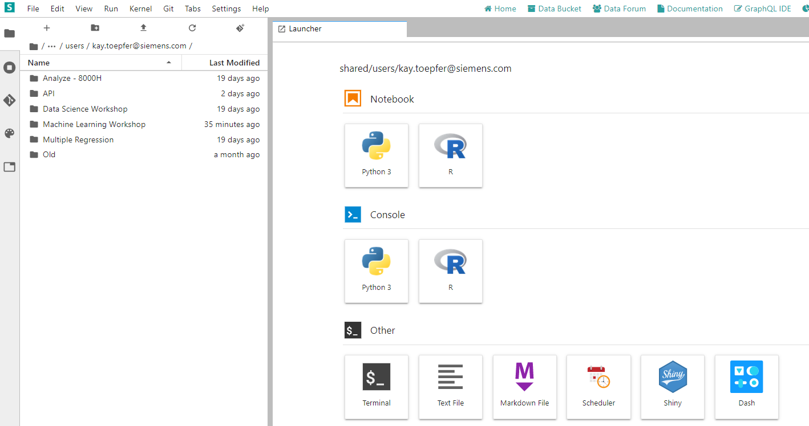
Click on Machine Learning Workshop

Slide 13
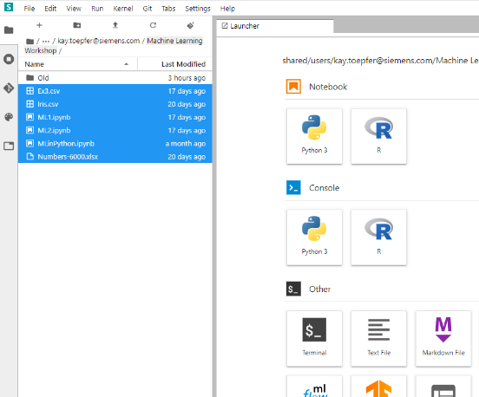
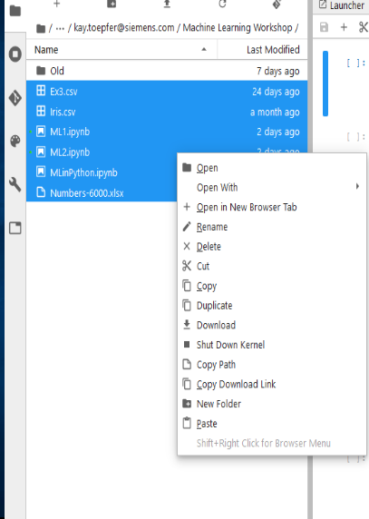
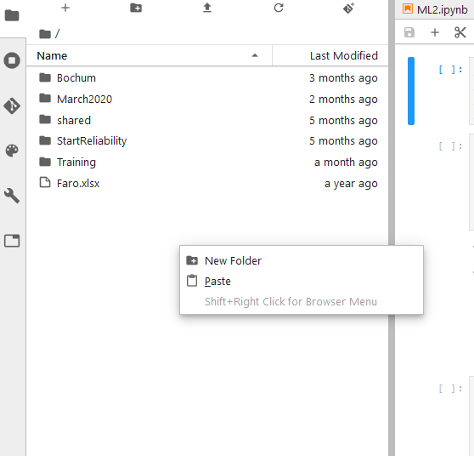
Copy All Files in Your Own Folder
2. Left Click on your folder
1. Right Click on Files -> Copy
3. Right Click -> Paste

Slide 14
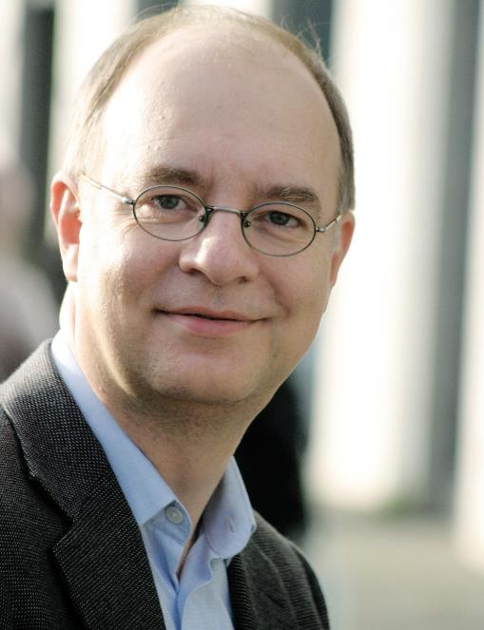
Matthias Groh, Your Instructor
Department “Improvement Projects” of SE Generation Quality
Data Science consultant
Six Sigma Master Black Belt
Previous engagements:
Senior Lean Expert focusing on administration processes @ Siemens Energy Fossil Products, Berlin, Germany
Director Six Sigma @ IIL, New York, NY
Six Sigma Black Belt @ Deutsche Bahn, Frankfurt, Germany
Professional degrees in:
Precision Mechanics
Mathematics
Psychology
If you need help, please contact our support mail box: dataScienceSupport.energy@siemens.com
To contact me personally, email me at groh.matthias@siemens-energy.com
Additional qualifications:
Certified Group Facilitator and Trainer (ABF)
Certified Six Sigma Master Black Belt (IIL)
Certified Project Management Professional (PMI)
Certified Senior Lean Expert (LMI)

Slide 15
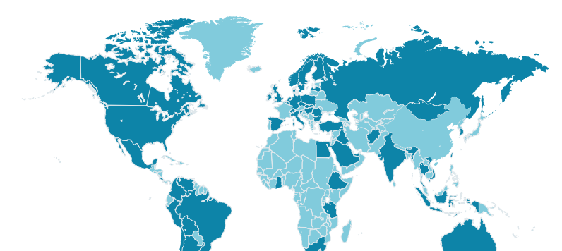













SE G QPI QM P – Improvement Projects The Team
Charlotte
Finspång
Berlin
Mülheim
Julie Davis Lean Principal Expert & Coach
Gunnel Sundberg Operational Excellence Consultant
Matthias Groh Master Black Belt
Jennifer Bottke
Head of Department
Jochen Uhde Root Cause Coordinator & Lead
Frank Unterlehberg
Master Black Belt
Marijana Šimleša Lean, Competency Management
Orlando
Ralf Flosbach
Lean Expert
Raymond Pcolar Master Black Belt & Lean Expert
Erlangen
Alexander Iannotta Advisory Expert Root Cause Expert
Tim Mazzotta Advisory Expert Data Analytics Expert
Bernd Buckard Senior Consultant Project / Claim Mgnt., Engineering.
Burkhard Ludes Business Excellence Consultant
Global diverse team – highly skilled, strong characters, strong ownership
Business support: Learning from organization - transferring experiences into other organizations
Connecting networks and develop new approaches
The P Team

Slide 16
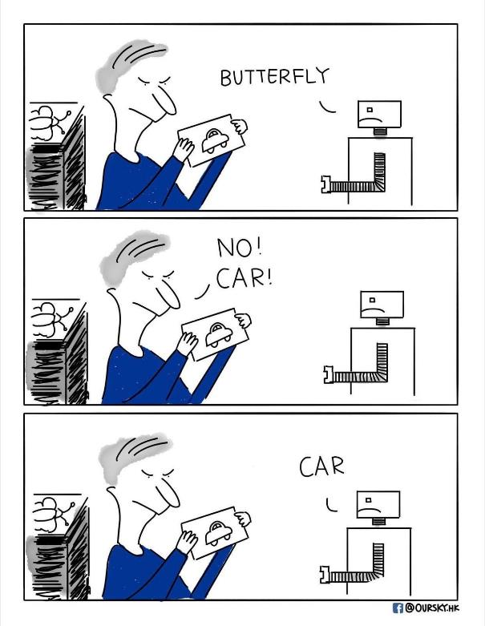
Please Quickly Introduce Yourself
Who is new (has not attended ML 1 class)?
Your name and function / organization
Your background regarding Machine Learning

Slide 17
Agenda
Review ML1
Model Evaluation:
Regression Quality Metrics
Classification Quality Metrics
The Bias-Variance Trade-Off
Model Types:
Decision Trees (Ensemble: Random Forrest)
Neural Networks
Basic Steps of Training a Neural Network
Neural Network Exercise
Application of Machine Learning in Our Business

Slide 18


Learning Types
Supervised Learning
Unsupervised Learning
“Features” (Xs) and “Targets” (Ys)
Example: Start Reliability
Y: Successful ignition / Failure ignition
Only “Features” (Xs)
Example: Amazon Customer analysis
X and Y are known
Exquisite
Preferred Price Class
P-Stage [mbar]
Only X are known
Cheap
D-Stage [mbar]
Purchases / week
Result: Model to predict Y: Y = f (X1, … , Xn)
i.e. for assuring next start is reliable
Result: Clusters to group customers in, i.e. for targeting advertisement
For our business „supervised learning“ is probably the most frequent relevant learning type

Slide 19

Having a „Supervised Learning“ Approach, We Should Distinguish between the Different Data Types of the Target Variable
The target variable is Attributive Numerical
40,45
39,97
40,85
38,93
39,12
40,07
success
failure
The learning approach is called:
„Classification“:
Selecting the right group for a new element
„Regression“: Estimates a numerical value for a new element
Most learning algorithms have a version for each,
Classification and Regression

Slide 20
Agenda
Review ML1
Model Evaluation:
Regression Quality Metrics
Classification Quality Metrics
The Bias-Variance Trade-Off
Model Types:
Decision Trees (Ensemble: Random Forrest)
Neural Networks
Basic Steps of Training a Neural Network
Neural Network Exercise
Application of Machine Learning in Our Business

Slide 21
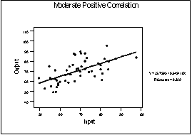
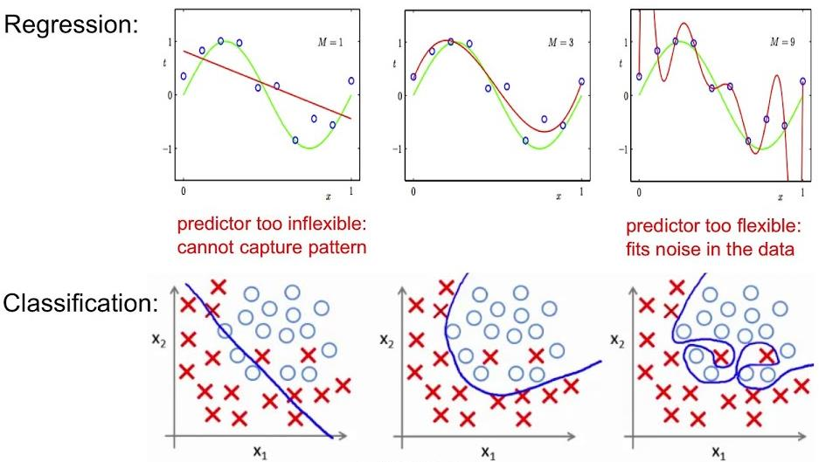
2 Questions to be answered by a Model
Does the model represent the given data in the best possible manner? (loss function, error metrics)
Is the Model general enough to still be valid for unknown data? (bias – variance tradeoff)
Notes:
In statistics normally the MSE is calculated by division with (n-p) with p - Number of x-variables in the model. In Big data analysis the -p can be neglected.

Slide 22
Agenda
Review ML1
Model Evaluation:
Regression Quality Metrics
Classification Quality Metrics
The Bias-Variance Trade-Off
Model Types:
Decision Trees (Ensemble: Random Forrest)
Neural Networks
Basic Steps of Training a Neural Network
Neural Network Exercise
Application of Machine Learning in Our Business

Slide 23
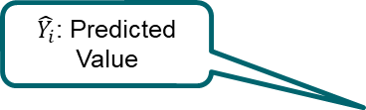
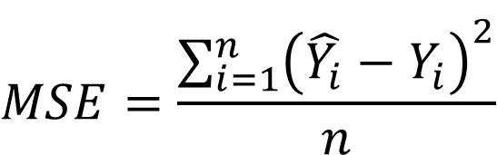

MSE Mean Squared Error as Error Metric and Loss Function
Simple linear model: y = ax+c
Error = Estimated value - True value
Mean squared error (MSE) measures the average of the squares of the errors
True (observed) value
Difference= “Error”= “Residual”
$\hat{Y_{i}}$: Predicted Value
By model estimated value
$$MSE=\frac{\sum_{i=1}^{n}{{\left(\hat{Y_{i}}−Y_{i}\right)}^{2}}}{n}$$
$Y_{i}$: Observed Value
Square Error
n: Sample Size
Think of the MSE as an squared average error the model makes while predicting.
Notes:
In statistics normally the MSE is calculated by division with (n-p) with p - Number of x-variables in the model. In Big data analysis the -p can be neglected.

Slide 24
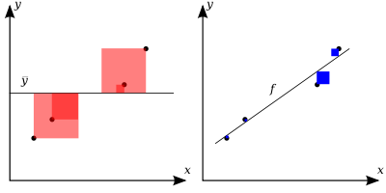

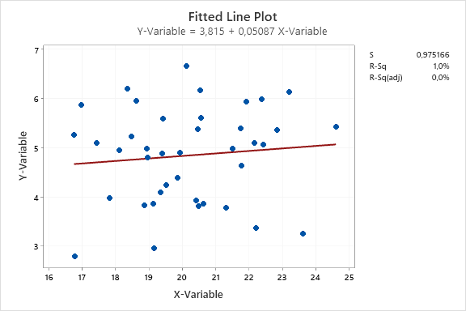
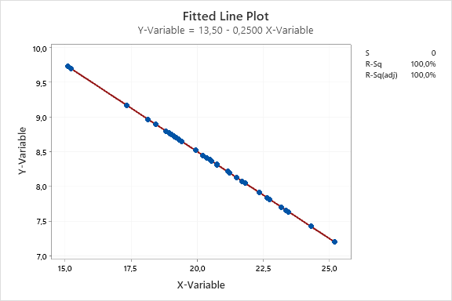
R-Square/ “Determination Coefficient”
Shows how much % of the variation of the target variable Y can be explained by the variation of the input variables X1, …, Xn
R-Sq = 100%:
Y can be 100% explained with X1-Xn
Modell matches observation perfectly
R-Sq = 0:
no correlation btw. X1-Xn and Y
Model explains randomness, no correlation btw. X1, …, Xn and Y

Slide 25
Overview: what we achieved so far
 | Target values | Loss function | Error metric | Act function last layer | Act func hidden layers
Regression | Continuous | MSE, R², MAE,… | MSE, R², MAE,…
Classification | Binary
 | multiple classes
 | Decision Trees | Artificial Neural Nets
Tabular data
Text
Images

Slide 26
Agenda
Review ML1
Model Evaluation:
Regression Quality Metrics
Classification Loss Function and Error Metrics
The Bias-Variance Trade-Off
Model Types:
Decision Trees (Ensemble: Random Forrest)
Neural Networks
Basic Steps of Training a Neural Network
Neural Network Exercise
Application of Machine Learning in Our Business

Slide 27
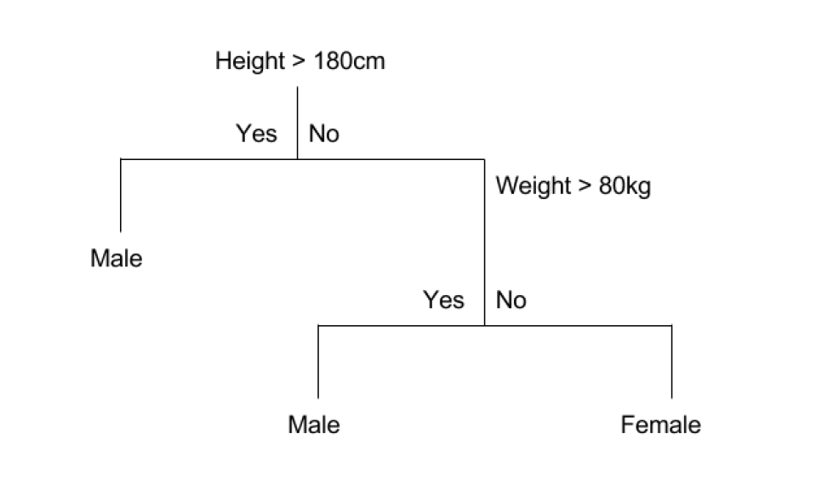
Classification by Decision Trees (Review ML1)
New wording CART (Classification and Regression Tree)
A crude example:
Notes:
No learning rate needed. CART select the best split, based on the highest information gain, by splitting between every value for each feature (X). If multiple splits have the same (best) information gain, the CART algo select one split randomly.

Slide 28

Main Idea How a Decision Tree Is Build (Review ML1): Which Loss Function to be minimized?
Start at the top: first node
Evaluate:
all input variables
all their possible split points
Which would have the least uncertainty
Split accordingly and generate two leaves
Repeat 2 + 3 with both leaves
Stop when:
Uncertainty can’t be further reduced
Some predefined metrics are reached:
Maximal depth (=consecutive branches)→ will play with this
Maximal # of leaves
Notes:
No learning rate needed. CART select the best split, based on the highest information gain, by splitting between every value for each feature (X). If multiple splits have the same (best) information gain, the CART algo select one split randomly.

Slide 29
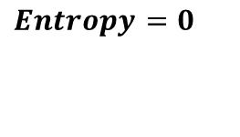
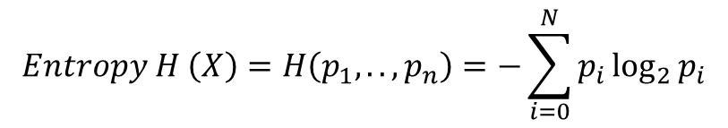
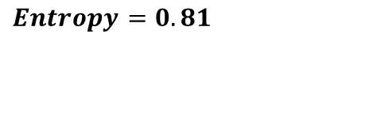
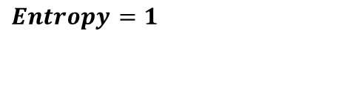
Uncertainty of a Dataset (Review ML1)
Entropy is used to measure uncertainty:
Entropy = 0: perfectly certain node(s)
Entropy >= 1: large mix of males and females
Goes back to the Shannon Entropy in physics
ENTROPY
+
+
+
$$Entropy H \left(X\right)=H\left(p_{1},..,p_{n}\right)=−\sum_{i=0}^{N}{p_{i}\log_{2}{p_{i}}}$$
$$Entropy=1$$
$$Entropy=0.81$$
$$Entropy=0$$
With Decreasing Entropy the Certainty Increases.

Slide 30
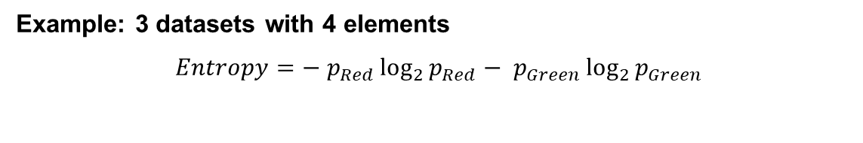
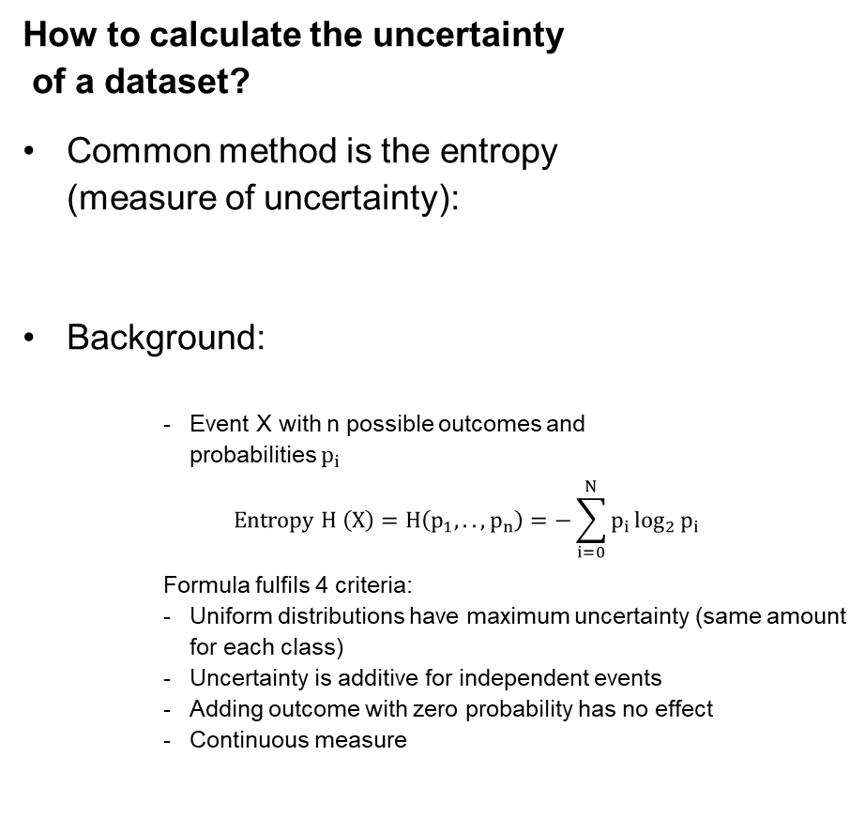
Loss Function: Entropy Measures Uncertainty of a Dataset
How to calculate the uncertainty of a dataset?
Common method is the entropy (measure of uncertainty):
Background:
Event X with n possible outcomes and probabilities $p_{i}$
$$Entropy H \left(X\right)=H\left(p_{1},..,p_{n}\right)=−\sum_{i=0}^{N}{p_{i}\log_{2}{p_{i}}}$$
Formula fulfils 4 criteria:
Uniform distributions have maximum uncertainty (same amount for each class)
Uncertainty is additive for independent events
Adding outcome with zero probability has no effect
Continuous measure
Example: 3 datasets with 4 elements
$$Entropy=− p_{Red}\log_{2}{p_{Red}− p_{Green}\log_{2}{p_{Green}}}$$

Slide 31
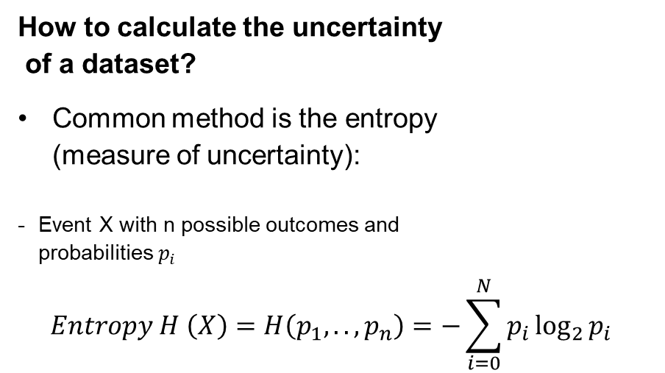
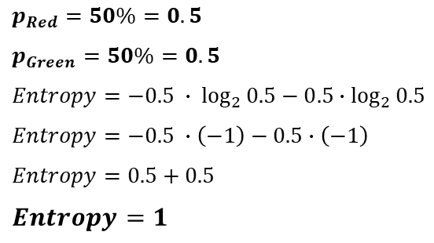
Loss Function: Entropy Measures Uncertainty of a Dataset
How to calculate the uncertainty of a dataset?
Common method is the entropy (measure of uncertainty):
Event X with n possible outcomes and probabilities $p_{i}$ $Entropy H \left(X\right)=H\left(p_{1},..,p_{n}\right)=−\sum_{i=0}^{N}{p_{i}\log_{2}{p_{i}}}$
Example: 3 datasets with 4 elements
$$Entropy=− p_{Red}\log_{2}{p_{Red}− p_{Green}\log_{2}{p_{Green}}}$$
$$p_{Red}=50\%=0.5$$
$$p_{Green}=50\%=0.5$$
$$Entropy=−0.5 ∙ \log_{2}{0.5}−0.5∙\log_{2}{0.5}$$
$$Entropy=−0.5 ∙\left(−1\right)−0.5∙\left(−1\right)$$
$$Entropy=0.5+0.5$$
$$Entropy=1$$

Slide 32
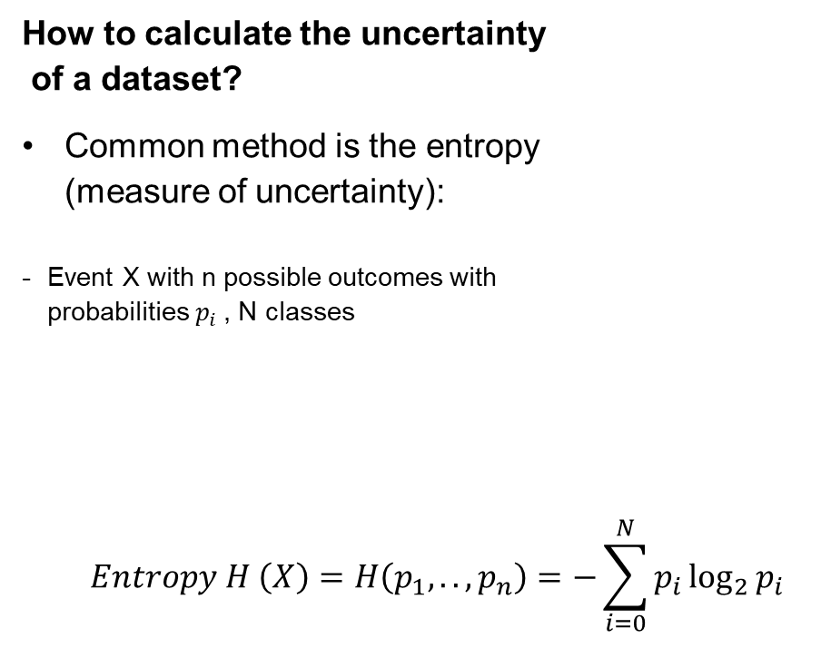
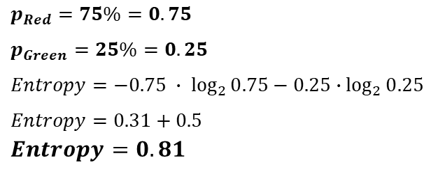
Loss Function: Entropy Measures Uncertainty of a Dataset
How to calculate the uncertainty of a dataset?
Common method is the entropy (measure of uncertainty):
Event X with n possible outcomes with probabilities $p_{i}$, N classes
$$Entropy H \left(X\right)=H\left(p_{1},..,p_{n}\right)=−\sum_{i=0}^{N}{p_{i}\log_{2}{p_{i}}}$$
Example: 3 datasets with 4 elements
$$Entropy=− p_{Red}\log_{2}{p_{Red}− p_{Green}\log_{2}{p_{Green}}}$$
$$Entropy=1$$
$$p_{Red}=75\%=0.75$$
$$p_{Green}=25\%=0.25$$
$$Entropy=−0.75 ∙ \log_{2}{0.75}−0.25∙\log_{2}{0.25}$$
$$Entropy=0.31+0.5$$
$$Entropy=0.81$$

Slide 33
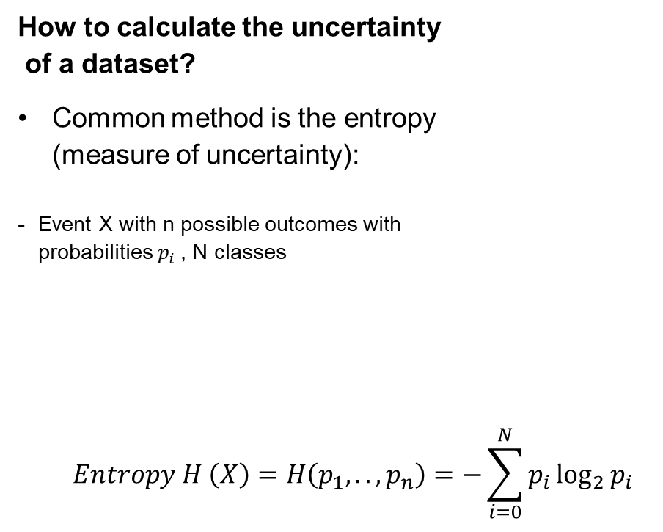
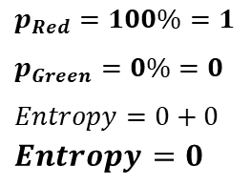
Loss Function: Entropy Measures Uncertainty of a Dataset
How to calculate the uncertainty of a dataset?
Common method is the entropy (measure of uncertainty):
Event X with n possible outcomes with probabilities $p_{i}$, N classes
$$Entropy H \left(X\right)=H\left(p_{1},..,p_{n}\right)=−\sum_{i=0}^{N}{p_{i}\log_{2}{p_{i}}}$$
Example: 3 datasets with 4 elements
$$Entropy=− p_{Red}\log_{2}{p_{Red}− p_{Green}\log_{2}{p_{Green}}}$$
$$Entropy=1$$
$$Entropy=0.81$$
$$p_{Red}=100\%=1$$
$$p_{Green}=0\%=0$$
$$Entropy=0+0$$
$$Entropy=0$$

Slide 34
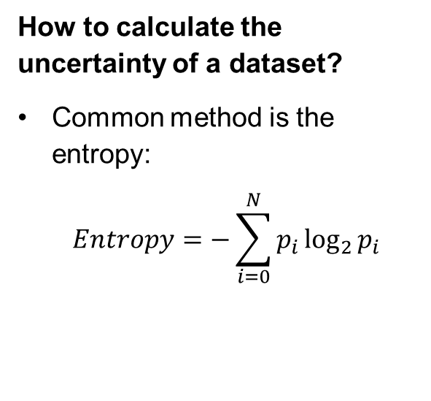
Loss Function: Entropy Measures Uncertainty of a Dataset
CERTAINTY
How to calculate the uncertainty of a dataset?
Common method is the entropy:
$$Entropy=−\sum_{i=0}^{N}{p_{i}\log_{2}{p_{i}}}$$
ENTROPY
$$Entropy=1$$
$$Entropy=0.81$$
$$Entropy=0$$
With Decreasing Entropy the Certainty Increases.

Slide 35
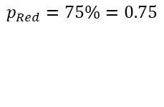
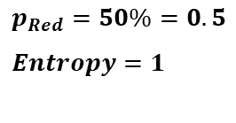
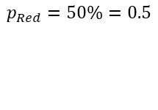
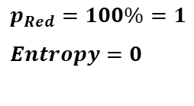
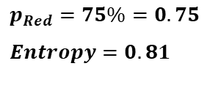
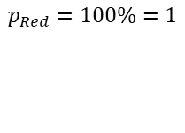
Loss Function: Entropy Measures Uncertainty of a Dataset
Certainty
Entropy
$$p_{Red}=50\%=0.5$$
$$p_{Red}=75\%=0.75$$
$$p_{Red}=50\%=0.5$$
$$Entropy=1$$
$$p_{Red}=75\%=0.75$$
$$Entropy=0.81$$
$$p_{Red}=100\%=1$$
$$Entropy=0$$
$$p_{Red}=100\%=1$$
With Decreasing Entropy the Certainty Increases.

Slide 36
Entropy Measures Impurity of a Dataset
Certainty
Entropy
$$p_{Red}=50\%=0.5$$
Where is this sample in the graph?
$$p_{Red}=75\%=0.75$$
$$p_{Red}=100\%=1$$
With Decreasing Entropy the Certainty Increases.

Slide 37
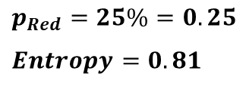
Entropy Measures Impurity of a Dataset
Purity
Entropy
$$p_{Red}=50\%=0.5$$
Where is this sample in the graph?
$$p_{Red}=75\%=0.75$$
$$p_{Red}=25\%=0.25$$
$$Entropy=0.81$$
$$p_{Red}=100\%=1$$
With Decreasing Entropy the Purity Increases.

Slide 38
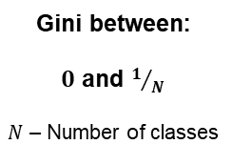
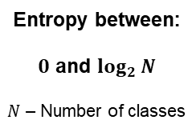
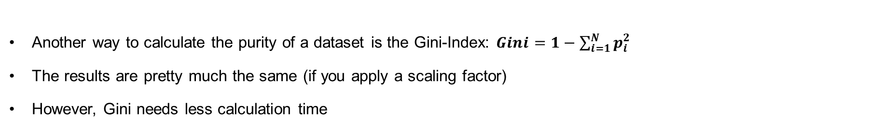
Gini-Index vs. Entropy to Measure Impurity of a Dataset
Another way to calculate the purity of a dataset is the Gini-Index: $Gini=1−\sum_{i=1}^{N}{p_{i}^{2}}$
The results are pretty much the same (if you apply a scaling factor)
However, Gini needs less calculation time
Entropy between:
$0$ and $\log_{2}{N}$
$N$ – Number of classes
Gini between:
$0$ and $1/N$
$N$ – Number of classes
No Clear Preference Which Index to Use.

Slide 39
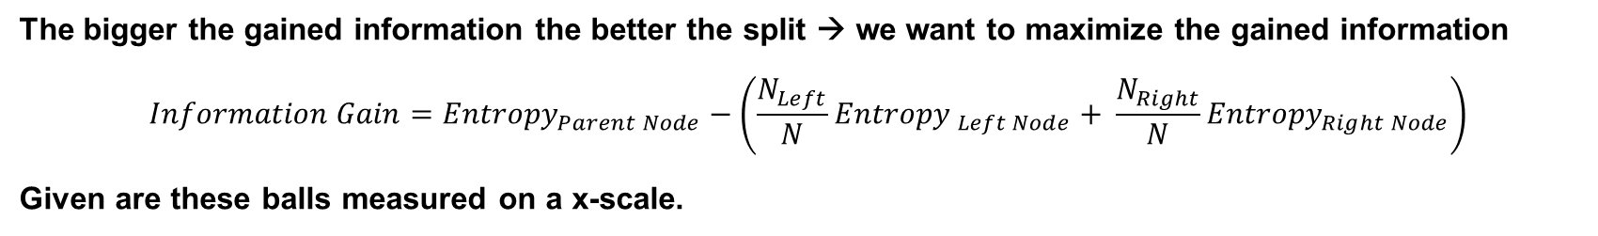
How to use the Entropy as a Loss Function? Information Gain (=Uncertainty reduction) as a Criteria for a Good Split
The bigger the gained information the better the split → we want to maximize the gained information
$$Information Gain={Entropy}_{Parent Node}−\left(\frac{N_{Left}}{N}{Entropy }_{Left Node}+ \frac{N_{Right}}{N}{Entropy}_{Right Node}\right)$$
Given are these balls measured on a x-scale.
x
0
1
2
3

Slide 40
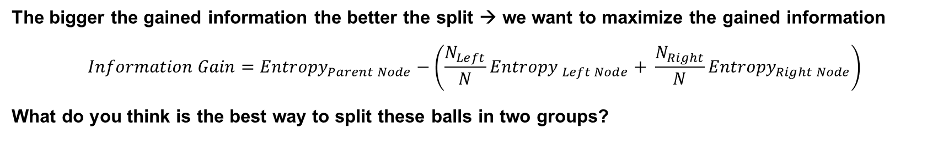
Information Gain as a Criteria for a Good Split
The bigger the gained information the better the split → we want to maximize the gained information
$$Information Gain={Entropy}_{Parent Node}−\left(\frac{N_{Left}}{N}{Entropy }_{Left Node}+ \frac{N_{Right}}{N}{Entropy}_{Right Node}\right)$$
What do you think is the best way to split these balls in two groups?
x
0
1
2
3
1.3
1.6
0
1
2
3
0
1
2
3
2.0
2.3
0
1
2
3
0
1
2
3

Slide 41
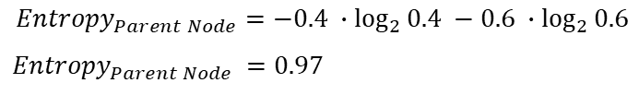
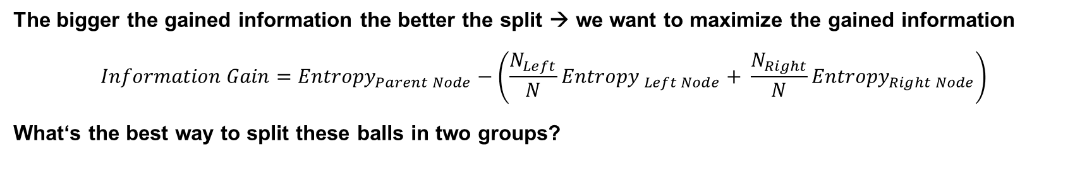
Information Gain as a Criteria for a Good Split
The bigger the gained information the better the split → we want to maximize the gained information
$$Information Gain={Entropy}_{Parent Node}−\left(\frac{N_{Left}}{N}{Entropy }_{Left Node}+ \frac{N_{Right}}{N}{Entropy}_{Right Node}\right)$$
What‘s the best way to split these balls in two groups?
$${Entropy}_{Parent Node}=−0.4 ∙\log_{2}{0.4} −0.6 ∙\log_{2}{0.6}$$
$${ Entropy}_{Parent Node} =0.97$$
x
0
1
2
3

Slide 42

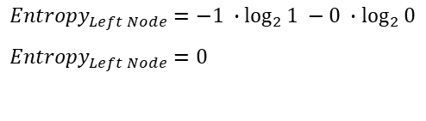
Information Gain as a Criteria for a Good Split
The bigger the gained information the better the split → we want to maximize the gained information
$$Information Gain={Entropy}_{Parent Node}−\left(\frac{N_{Left}}{N}{Entropy }_{Left Node}+ \frac{N_{Right}}{N}{Entropy}_{Right Node}\right)$$
What‘s the best way to split these balls in two groups?
$${Entropy}_{Parent Node}=−0.4 ∙\log_{2}{0.4} −0.6 ∙\log_{2}{0.6}$$
$${ Entropy}_{Parent Node} =0.97$$
x
0
1
2
3
$${Entropy}_{Left Node}=−1 ∙\log_{2}{1 −0 ∙\log_{2}{0}}$$
$${Entropy}_{Left Node}=0$$
$${Entropy}_{Left Node}$$

Slide 43

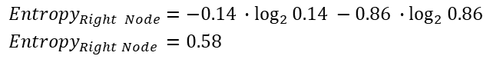
Information Gain as a Criteria for a Good Split
The bigger the gained information the better the split → we want to maximize the gained information
$$Information Gain={Entropy}_{Parent Node}−\left(\frac{N_{Left}}{N}{Entropy }_{Left Node}+ \frac{N_{Right}}{N}{Entropy}_{Right Node}\right)$$
What‘s the best way to split these balls in two groups?
$${Entropy}_{Parent Node}=−0.4 ∙\log_{2}{0.4} −0.6 ∙\log_{2}{0.6}$$
$${ Entropy}_{Parent Node} =0.97$$
x
0
1
2
3
$${Entropy}_{Left Node}=−1 ∙\log_{2}{1 −0 ∙\log_{2}{0}}$$
$${Entropy}_{Left Node}=0$$
$${Entropy}_{Right Node}=−0.14 ∙\log_{2}{0.14 −0.86 ∙\log_{2}{0.86}}$$
$${Entropy}_{Right Node }=0.58$$
$${Entropy}_{Right Node}$$
$${Entropy}_{Left Node}$$

Slide 44

Information Gain as a Criteria for a Good Split
The bigger the gained information the better the split → we want to maximize the gained information
$$Information Gain={Entropy}_{Parent Node}−\left(\frac{N_{Left}}{N}{Entropy }_{Left Node}+ \frac{N_{Right}}{N}{Entropy}_{Right Node}\right)$$
What‘s the best way to split these balls in two groups?
$${Entropy}_{Parent Node}=−0.4 ∙\log_{2}{0.4} −0.6 ∙\log_{2}{0.6}$$
$${ Entropy}_{Parent Node} =0.97$$
x
0
1
2
3
$${Entropy}_{Left Node}=−1 ∙\log_{2}{1 −0 ∙\log_{2}{0}}$$
$${Entropy}_{Left Node}=0$$
$${Entropy}_{Right Node}=−0.14 ∙\log_{2}{0.14 −0.86 ∙\log_{2}{0.86}}$$
$${Entropy}_{Right Node }=0.58$$
$${Entropy}_{Right Node}$$
Split at 1,3: $Info Gain=0.97−\left(\frac{3}{10}0+\frac{7}{10}0.58\right)$
$Info Gain=0.56$
$${Entropy}_{Left Node}$$

Slide 45


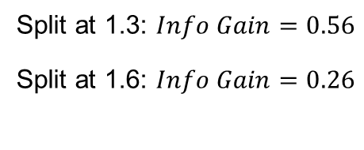

Information Gain as a Criteria for a Good Split
The bigger the gained information the better the split → we want to maximize the gained information
$$Information Gain={Entropy}_{Parent Node}−\left(\frac{N_{Left}}{N}{Entropy }_{Left Node}+ \frac{N_{Right}}{N}{Entropy}_{Right Node}\right)$$
What‘s the best way to split these balls in two groups?
$${Entropy}_{Parent Node}=−0.4 ∙\log_{2}{0.4} −0.6 ∙\log_{2}{0.6}$$
$${ Entropy}_{Parent Node} =0.97$$
x
0
1
2
3
$${Entropy}_{Left Node}=0.81$$
$${Entropy}_{Right Node}=0.65$$
$${Entropy}_{Left Node}$$
Split at 1.3: $Info Gain=0.56$
Split at 1.6: $Info Gain=0.26$
$${Entropy}_{Right Node}$$

Slide 46

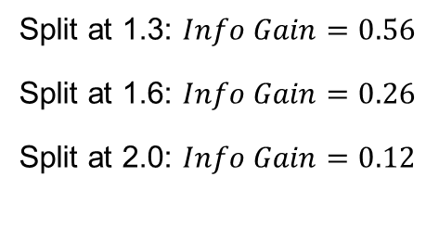



Information Gain as a Criteria for a Good Split
The bigger the gained information the better the split → we want to maximize the gained information
$$Information Gain={Entropy}_{Parent Node}−\left(\frac{N_{Left}}{N}{Entropy }_{Left Node}+ \frac{N_{Right}}{N}{Entropy}_{Right Node}\right)$$
What‘s the best way to split these balls in two groups?
$${Entropy}_{Parent Node}=−0.4 ∙\log_{2}{0.4} −0.6 ∙\log_{2}{0.6}$$
$${ Entropy}_{Parent Node} =0.97$$
x
0
1
2
3
$${Entropy}_{Left Node}$$
$${Entropy}_{Left Node}=0.87$$
$${Entropy}_{Right Node}=0.72$$
Split at 1.3: $Info Gain=0.56$
Split at 1.6: $Info Gain=0.26$
Split at 2.0: $Info Gain=0.12$
$${Entropy}_{Right Node}$$

Slide 47



Information Gain as a Criteria for a Good Split
The bigger the gained information the better the split → we want to maximize the gained information
$$Information Gain={Entropy}_{Parent Node}−\left(\frac{N_{Left}}{N}{Entropy }_{Left Node}+ \frac{N_{Right}}{N}{Entropy}_{Right Node}\right)$$
What‘s the best way to split these balls in two groups?
$${Entropy}_{Parent Node}=−0.4 ∙\log_{2}{0.4} −0.6 ∙\log_{2}{0.6}$$
$${ Entropy}_{Parent Node} =0.97$$
x
0
1
2
3
$${Entropy}_{Left Node}$$
$${Entropy}_{Left Node}=0.91$$
$${Entropy}_{Right Node}=0$$
Split at 1.3: $Info Gain=0.56$
Split at 1.6: $Info Gain=0.26$
Split at 2.0: $Info Gain=0.12$
Split at 2.3: $Info Gain=0.42$
$${Entropy}_{Right Node}$$

Slide 48

Information Gain as a Criteria for a Good Split (Loss Function)
The bigger the gained information the better the split → we want to maximize the gained information
$$Information Gain={Entropy}_{Parent Node}−\left(\frac{N_{Left}}{N}{Entropy }_{Left Node}+ \frac{N_{Right}}{N}{Entropy}_{Right Node}\right)$$
What‘s the best way to split these balls in two groups?
x
0
1
2
3
1.3
1.6
0
1
2
3
0
1
2
3
2.0
2.3
0
1
2
3
0
1
2
3

Slide 49
Towards an Error Metric for Classification: Confusion Matrix
Reality
 | Positive | Negative
Predicted Positive | True Positive | False Positive
Predicted Negative | False Negative | True Negative

Slide 50
Towards an Error Metric for Classification: Confusion Matrix
0
1
2
3
 | Green | Red
Predicted Green | 6
Predicted Red

Slide 51
Towards an Error Metric for Classification: Confusion Matrix
0
1
2
3
 | Green | Red
Predicted Green | 6
Predicted Red | 0

Slide 52
Towards an Error Metric for Classification: Confusion Matrix
0
1
2
3
 | Green | Red
Predicted Green | 6 | 1
Predicted Red | 0

Slide 53
Towards an Error Metric for Classification: Confusion Matrix
0
1
2
3
 | Green | Red
Predicted Green | 6 | 1
Predicted Red | 0 | 3

Slide 54

Error Metric: Accuracy
Reality
 | Positive | Negative
Predicted Positive | True Positive | False Positive
Predicted Negative | False Negative | True Negative
$$Accuracy=Test Score= \frac{True Positive+True Negative}{Number of all Predictions}$$

Slide 55

Error Metric: Accuracy
0
1
2
3
 | Green | Red
Predicted Green | 6 | 1
Predicted Red | 0 | 3
$$Accuracy=Test Score= \frac{True Greens+True Reds}{\# all Predictions}= \frac{6+3}{10}=0.9$$

Slide 56
Problems with Accuracy
Example:
Classifier: medical data, predict if person has disease or not; highly imbalanced classes
Result: high accuracy, BUT :
Always correctly diagnosed disease, but it gets half of the healthy people wrong. (precision)
Right for every healthy person, but misses half of the disease cases. (recall)
Accuracy doesn’t help. What’s important is that no matter if someone is sick or healthy the classifier gets it right.
Let’s say you are screening a population for a sickness that occurs only 1 in a 1 000 cases. Would a classifier that is 99.9% accurate seems good ? Well intuitively yes, but the classifier could just predict every person is healthy and get it right 999 out of 1000 times, so it would be 99.9% accurate. Huh. Not good.

Slide 57



Error Metric: Precision
How many positive/green predictions are actual positive/true greens?
0
1
2
3
How valid are the search results?
Use precision if predicting right is important (have all patients diagnosed by the classifier really had the disease?)
Reality
 | Positive | Negative
Predicted Positive | True Positive 6 | False Positive 1
Predicted Negative | False Negative 0 | True Negative 3
$$Precision= \frac{True Positive}{Number of all Positive Predictions}$$
$$Precision= \frac{True Greens}{\# all Green Predictions}= \frac{6}{7}=0.86$$

Slide 58


Error Metric: Recall
How many positives/greens are predicted as positive/green?
How complete are the results?
Use recall if finding all is important (are all patients with the disease detected?)
0
1
2
3
Reality
 | Positive | Negative
Predicted Positive | True Positive 6 | False Positive 1
Predicted Negative | False Negative 0 | True Negative 3
$$Recall= \frac{True Positive}{Number of all Positive Elements}$$
$$Recall= \frac{True Greens}{\# all Green Elements}= \frac{6}{6}=1$$

Slide 59

Model Quality: Precision
How many green predictions are actual green?
$$Precision= \frac{True Greens}{\# all Green Predictions}= \frac{6}{7}=0.86$$
0
1
2
3
 | Green | Red
Predicted Green | 6 | 1
Predicted Red | 0 | 3

Slide 60


Model Quality: Recall
Reality
 | Positive | Negative
Predicted Positive | True Positive | False Positive
Predicted Negative | False Negative | True Negative
$$Precision= \frac{True Positive}{Number of all Positive Predictions}$$
How many positive predictions are actual positive?
$$Recall= \frac{True Positive}{Number of all Positive Elements}$$
How many positive are positive predicted?

Slide 61

Model Quality: Recall
0
1
2
3
 | Green | Red
Predicted Green | 6 | 1
Predicted Red | 0 | 3
How many greens are green predicted?
$$Recall= \frac{True Greens}{\# all Green Elements}= \frac{6}{6}=1$$

Slide 62


Error Metric: F1 Score
Reality
 | Positive | Negative
Predicted Positive | True Positive | False Positive
Predicted Negative | False Negative | True Negative
$$Precision= \frac{True Positive}{Number of all Positive Predictions}$$
How many positive predictions are actual positive?
$$Recall= \frac{True Positive}{Number of all Positive Elements}$$
$$F1 Score=2∙\frac{Precision ∙Recall}{Precision+Recall}$$
How many positive are positive predicted?
Tradeoff of Precision and Recall. Harmonic mean of precision and recall

Slide 63

Error Metric: F1 Score
0
1
2
3
 | Green | Red
Predicted Green | 6 | 1
Predicted Red | 0 | 3
Tradeoff of precision and recall.
$$F1 Score=2∙\frac{Precision ∙Recall}{Precision+Recall}=2∙\frac{0.86∙1}{0.86+1}=0.92$$

Slide 64




Error Metrics: Accuracy, Precision, Recall and F1 Score
Reality
 | Positive | Negative
Predicted Positive | True Positive | False Positive
Predicted Negative | False Negative | True Negative
$$Precision= \frac{True Positive}{Number of all Positive Predictions}$$
How many positive predictions are actual positives?
$$Recall= \frac{True Positive}{Number of all Positive Elements}$$
$$F1 Score=2∙\frac{Precision ∙Recall}{Precision+Recall}$$
How many positive are positive predicted?
Tradeoff of precision and recall.
$$Accuracy=Test Score= \frac{True Positive+True Negative}{Number of all Predictions}$$
https://towardsdatascience.com/should-i-look-at-precision-recall-or-specificity-sensitivity-3946158aace1

Slide 65



Error Metrics: Accuracy, Precision, Recall and F1 Score
How many green predictions are actual green?
$$Precision= \frac{True Greens}{\# all Green Predictions}= \frac{6}{7}=0.86$$
0
1
2
3
 | Green | Red
Predicted Green | 6 | 1
Predicted Red | 0 | 3
How many greens are green predicted?
$$Recall= \frac{True Greens}{\# all Green Elements}= \frac{6}{6}=1$$
Tradeoff of precision and recall.
$$F1 Score=2∙\frac{Precision ∙Recall}{Precision+Recall}=2∙\frac{1∙0.86}{1+0.86}=0.92$$
$$Accuracy=Test Score= \frac{True Greens+True Reds}{\# all Predictions}= \frac{6+3}{10}=0.9$$

Slide 66


Exercise 1.1: Quiz
https://forms.office.com/r/yGdHArDsHu
https://forms.office.com/Pages/DesignPage.aspx#
Intern
Notes:
https://forms.office.com/Pages/DesignPage.aspx#

Slide 67
Overview: what we achieved so far
 | Target values | Loss function | Error metric | Act function last layer | Act func hidden layers
Regression | Continuous | MSE, R², MAE,… | MSE, R², MAE,…
Classification | Binary | Binary cross entropy | F1 score, precision, recall, ROC-curve
 | multiple classes | categorical cross entropy | F1 score, precision, recall, ROC-curve
 | Decision Trees | Artificial Neural Nets
Tabular data
Text
Images

Slide 68
Agenda
Review ML1
Model Evaluation:
Regression Quality Metrics
Classification Quality Metrics
The Bias-Variance Trade-Off
Model Types:
Decision Trees (Ensemble: Random Forrest)
Neural Networks
Basic Steps of Training a Neural Network
Neural Network Exercise
Application of Machine Learning in Our Business

Slide 69
Limitations for generalization of Model (known and unknown data) Overview (New Compared to ML1 in Red)
Error Type
Summary
Details
Consequences
How to prevent it
Model Error
Bias Error/ Underfitting
Model is too simple
The (unknown) true target function is more complex than the model.
High forecasting error both in known and unknown data
Model doesn’t vary much when adding new data points
Review with domain experts
Analyze residuals
Increase complexity
Variance Error/ Overfitting
Modell is too complex
The true target function is simpler than the model. Common reason: model tries to overcome irreducible error/ noise.
High forecasting error in unknown data, not in known data
Model varies a lot when adding new data points
Review with domain experts
Split data in training and test data
k-fold cross validation
Irreducible Error
Data are not sufficient/ Noise
Factors which were not measured have an impact:
not measured input variables
environmental factors
measurement errors
sampling bias, …
Model varies not a lot when adding new data points
Can not be reduced by change of algorithm!
Review with domain experts
Collect better data
Any built model build is an approximation of a true target function and therefore includes errors.

Slide 70

Bias-Variance Trade-Off
Occam‘s razor: The simplest model/most intuitive method is preferable
Notes:
William of Ockham, a Franciscan friar who studied logic in the 14th century, first made this principle well known.^{[1]}
William of Ockham wrote “More things should not be used than are necessary.”
This means if there are several possible ways something might have happened, the way which uses the fewest guesses is probably the correct one. However, Occam's razor only applies when the simple explanation and complex explanation both work equally well. If a more complex explanation does a better job than a simpler one, then you should use the complex explanation.
https://simple.wikipedia.org/wiki/Occam%27s_razor

Slide 71
Model Selection: Under- and Overfitting for Numerical and Categorical Target Variables
True, unknown target function
Model target function
Variance/ Overfitting
Bias / underfitting

Slide 72
Machine Learning Libraries Offer Countless Model Options Some of Them Tend to Have Bias, Other May Tend to Overfitting
Variance
Overfitting
Bias
Underfitting
Linear regression
Random forests
Convolutional neural networks (CNN)
Non-linear regression
Simple neural networks
DAS IST QUATSCH!!! Of course, it depends on the problem at hand:
For truly linear relationships, linear regression will not have bias.
For complex problems the danger is to overfit using complex tools
Try to use technical expertise and keep the model as simple as possible, but not simpler.

Slide 73


How to Prevent Overfitting 1: Split Dataset into Training and Test Data
Polynomial 1st degree
Optimal model
Train data
Polynomial 4th degree
Accuracy
Test data
„Bias“
„Overfitting“
Model complexity
E.g. the number of predictors
or the polynomial degree
(both resulting in a larger number of coefficients)

Slide 74
How to Prevent Overfitting 2: k-Fold Cross Validation
Used if number of training data is limited
Parameter k: data is split into k subgroups
i.e. k=10 data is split into 10 groups.
Generally model evaluation is less biased than with simple train/test split
General procedure :
Shuffle the dataset randomly.
Split the dataset into k groups
For each unique group:
Take the group as a hold out or test data set
Take the remaining groups as a training data set
Fit a model on the training set and evaluate it on the test set
Retain the evaluation score and discard the model
Summarize the skill of the model using the sample of model evaluation scores
k subgroups -> k models: one subgroup is test dataset, rest is training data set.
Average the results.
Source: https://machinelearningmastery.com/k-fold-cross-validation/
Notes:
Important: Each observation in the data sample is assigned to an individual group and stays in that group for the duration of the procedure. This means that each sample is given the opportunity to be used in the hold out set 1 time and used to train the model k-1 times.

Slide 75


Exercise 1.2: Quiz
https://forms.office.com/r/d0fArXiVtm
https://forms.office.com/Pages/DesignPage.aspx#
Intern
Notes:
https://forms.office.com/Pages/DesignPage.aspx#

Slide 76
Model Limitations (Review)
Error Type
Summary
Details
Consequences
How to prevent it
Model Error
Bias Error/ Underfitting
Model is too simple
The (unknown) true target function is more complex than the model.
High forecasting error both in training and test data
Model doesn’t vary much with changing training data
Review with domain experts
Analyze residuals
Increase complexity
Variance Error/ Overfitting
Modell is too complex
The true target function is simpler than the model. Common reason: model tries to overcome irreducible error
High forecasting error in test data, not in training data
Model varies a lot with changing training data
Review with domain experts
Split data in training and test data
k-fold cross validation
Irreducible Error
Data are not sufficient
Factors which were not measured have an impact:
not measured input variables
environmental factors
measurement errors
sampling bias, …
Model varies not a lot with changing (same type of) training data
Can not be reduced with different algorithm!
Review with domain experts
Collect better data
Any build model build is an approximation of a true target function and therefore includes errors.

Slide 77
Overview: what we achieved so far
 | Target values | Loss function | Error metric | Act function last layer | Act func hidden layers
Regression | Continuous | MSE, R², MAE,… | MSE, R², MAE,…
Classification | Binary | Binary cross entropy | F1 score, precision, recall, ROC-curve
 | multiple classes | categorical cross entropy | F1 score, precision, recall, ROC-curve
 | Decision Trees | Artificial Neural Nets
Tabular data
Text
Images

Slide 78
Agenda
Review ML1
Model Evaluation:
Regression Quality Metrics
Classification Quality Metrics
The Bias-Variance Trade-Off
Model Types:
Decision Trees (Ensemble: Random Forrest)
Neural Networks
Basic Steps of Training a Neural Network
Neural Network Exercise
Application of Machine Learning in Our Business

Slide 79
Overview: what comes next
 | Target values | Loss function | Error metric | Act function last layer | Act func hidden layers
Regression | Continuous | MSE, R², MAE,… | MSE, R², MAE,…
Classification | Binary | Binary cross entropy | F1 score, precision, recall, ROC-curve
 | multiple classes | categorical cross entropy | F1 score, precision, recall, ROC-curve
 | Decision Trees | Artificial Neural Nets
Tabular data | Ensemble methods: Random Forest, Boosting | Starting from simple architectures
Text | - | Transformers (encoding, decoding, attention)
Images | - | CNNs

Slide 80
Agenda
Review ML1
Model Evaluation:
Regression Quality Metrics
Classification Quality Metrics
The Bias-Variance Trade-Off
Model Types:
Decision Trees (Ensemble: Random Forrest)
Neural Networks
Basic Steps of Training a Neural Network
Neural Network Exercise
Application of Machine Learning in Our Business

Slide 81

Recall: Bias-Variance Trade-Off
Occam‘s razor: The simplest model/most intuitive method is preferable
Notes:
William of Ockham, a Franciscan friar who studied logic in the 14th century, first made this principle well known.^{[1]}
William of Ockham wrote “More things should not be used than are necessary.”
This means if there are several possible ways something might have happened, the way which uses the fewest guesses is probably the correct one. However, Occam's razor only applies when the simple explanation and complex explanation both work equally well. If a more complex explanation does a better job than a simpler one, then you should use the complex explanation: https://simple.wikipedia.org/wiki/Occam%27s_razor
Notes 81

Slide 82

Classification and Regression Tree (CART): Pros and Cons
Pros | Cons
explainable little data preparation implicit selection of features can handle non-linearities Computationally efficient | without adaptions not very robust (=changes with diff. data) overfitting local optimal decisions per node → globally optimized decision tree not guaranteed
Decision Trees themselves are rather weak - BUT: it is easy to address their Bias and Variance problems

Slide 83

Ensemble Methods: Improve Decision Trees by Model Averaging
Construct more than one Decision Tree and average!
Address Variance by:
Bootstrapping and aggregating (= Bagging: parallel: samples with replacement/ average predictions)
Random Feature Selection
Address Bias by:
Boosting (sequential: next tree only on errors of first tree) → not our focus, just and excursion
Random Forest

Slide 84


Random Forests: Bagging + Random Feature Selection
Bootstrap Aggregating (Bagging):
Number of Estimators n (~100):
create n subsamples, build n models and aggregate results
(bootstrapping: random sampling with replacement)
Random Feature Selection:
for each of the n subsamples: random set of m features (Xs) is used to construct Decision Tree
m is typically $\sqrt{M}$ or $\log_{2}(M)$ with M being the total number of features
Random set of features
Random set of features
Random set of features

Slide 85
Random Forests: Example for One Tree
draw subsample with replacement
 | age | size | weight | health
1. | old | tall | heavy | diseased
2. | young | small | light | healthy
3. | old | small | heavy | healthy
4. | young | small | light | healthy
5. | old | tall | heavy | diseased
6. | young | tall | light | diseased
7. | young | tall | light | healthy
 | age | size | weight | health
1. | old | tall | heavy | diseased
2. | young | small | light | healthy
3. | old | small | heavy | healthy
4. | old | small | heavy | healthy
for each of n subsamples:
draw a random sample with replacement of training data
select m features at random
grow a Tree from subsample and selected features
In the end:
aggregate results of all trees for overall result
In Classification: each data point gets labeled according to class it was identified as in most Trees
In Regression: e.g. calculate mean
select features
 | age | size | health
1. | old | tall | diseased
2. | young | small | healthy
3. | old | small | healthy
4. | old | small | healthy
attributes: age, size, weight
Target classes: healthy/diseased
age
grow Tree
young
old
size
healthy
tall
small
diseased
healthy
In Comparison to a single Decision Tree: average has smaller prediction Variance which leads to a better performance, but therefore algorithm is a „black box“

Slide 86

Random Forests: Classification

Slide 87

Random Forests: Regression
Example for Regression Trees: value = calculate something like a mean for each node or leaf

Slide 88


Recall Number Recognition Example from ML1
X-Variables: 28x28 = 784 variables with pixel data
X-Range: 0-255 for intensity of the pixel
Y-Variable: correct number: 0, 1, …., 9
Numbers (700): 630 training data + 70 test data
Easy to identify:
Hard to identify:

Slide 89

Exercise 2.1: Random Forest Vs. Decision Trees
Open the ML2.ipynb Notebook
Run through all cells till Exercise 2.1: Decision Trees vs. Random Forest (shift+enter)
Repeat:
Change the max depth (1-20) and create random forests and decision trees for each max depth you choose (shift+enter)
For random forest default number of estimators is 100

Slide 90

Exercise 2.1: Random Forest Vs. Decision Trees
We get better results from random forest!
Similar trend for random forest and decision tree

Slide 91

Exercise 2.2: Explore the Influence of #Estimators (#Models/Subsamples) of Random Forests
Go to Exercise 2.2: Random Forest
Enter the max depth you think is the best
Change the number of estimators (1-30) and create random forests
What do you think is a good number of estimators?
Default number of estimators is 100

Slide 92

Exercise 2.2: Explore the Influence of #Estimators of Random Forests
We use Max Depth = 8
In our example seems 6 - 12 to be a good number of estimators

Slide 93
Observed Parameters for Decision Tree and Random Forest in Python
from sklearn.tree import DecisionTreeClassifier
DecisionTreeClassifier(criterion=‘entropy’,max_depth=1)
For more information go to: https://scikit-learn.org/stable/modules/generated/sklearn.tree.DecisionTreeClassifier.html#sklearn.tree.DecisionTreeClassifier
Gini or Entropy – How the purity of the dataset should measured (default: ‘gini’)
Maximal depth of the tree (default: None)
from sklearn.ensemble import RandomForestClassifier
RandomForestClassifier(criterion=‘entropy',max_depth=1,n_estimators=1)
For more information go to: https://scikit-learn.org/stable/modules/generated/sklearn.ensemble.RandomForestClassifier.html
Number of build models / subsets (default: 100)
There are a lot more parameters you can variate to perfect your model. But therefore it‘s not always easy
to find a very good combination of parameters.

Slide 94

Excursus: Boosting
Improve a Decision Tree by running it multiple times on weighted training data.
Iteratively:
draw a sample from data with replacement. In first iteration each data point has equal likeliness to be chosen
grow the Tree from sample
evaluate which data points in training data were incorrectly labeled
these data points get weighted higher
thus more likely to be chosen in next sample drawing
In the end:
aggregate results of all trees for overall
result

Slide 95
Decision Tree Algorithms: Sum up
Decision Trees itself are rather weak ML algorithms
However, with little tricks they can become VERY powerful and at the same time computationally efficient (compared to NNs):
Random Forests (focus this training):
Bagging
Random feature selection
-> fully grown trees (high variance, low bias): average different overfitted trees
Boosting (considered for future trainings)
-> shallow trees (high bias, low variance): sequentially reduce bias

Slide 96
Overview: what we achieved so far
 | Target values | Loss function | Error metric | Act function last layer | Act func hidden layers
Regression | Continous | MSE, R², MAE,… | MSE, R², MAE,…
Classification | Binary | Binary cross entropy | F1 score, precision, recall, ROC-curve
 | multiple classes | categorical cross entropy | F1 score, precision, recall, ROC-curve
 | Decision Trees | Artificial Neural Nets
Tabular data | Ensemble methods: Random Forest, Boosting | Starting from simple architectures
Text | - | Transformers (encoding, decoding, attention)
Images | - | CNNs

Slide 97
Agenda
Review ML1
Model Evaluation:
Regression Quality Metrics
Classification Quality Metrics
The Bias-Variance Trade-Off
Model Types:
Decision Trees (Ensemble: Random Forrest)
Neural Networks
Basic Elements and Steps of Training a Neural Network
Neural Network Exercise
Application of Machine Learning in Our Business

Slide 98


Review: Artificial Neural Nets (ANN) Are Highly Complex Models Inspired by the Biological Neural Networks that Constitute Brains
With just ~100.000 neurons a fruit fly brain can:
Fly
Find food
Realize and avoid danger
…
All our computers have much more calculation capacity than 100.000 neurons
Why is it hard for computers to do what a fruit fly can?
Adapted from: Tariq Rashid “ Make Your Own Neural Network”
Notes:
Dendriten: nehmen Reize auf und leiten diese zum Soma weiter
Soma: Zellkörper, der sogenannte Axonhügel und den Zellkern enthält
Axonhügel: Postsynaptische Signale addieren sich auf, Erregung wird aber nur weitergeleitet, wenn ein gewisser Schwellenwert überschritten wird → nicht alle Signale/Reize werden aufgenommen (würde uns überfordern und höchstwahrscheinlich zum Tode führen)
Axon: langer Nervenzellfortsatz, der die elektrischen Reize vom Soma zur nächsten Nervenzelle weitergibt
Synaptische Endköpfchen/Synapsen: am Ende des Axoms befinden sich die snyaptischen Endköpfe, welche mit Hilfe des übertragenen Spannungspotenials eine chemische Reaktion auslösen → Neurotransmitter werden im synaptischen Spalt freigesetzt und dieses chemische Signal wird wieder in ein elektrisches Signal umgewandelt und an die nächsten Dendriten weitergegeben.
Menschliche Gehirn enthält circa 1 Billion (1 mit 12 Nullen) Neuronen

Slide 99


Neural Networks Take Key Inspirations from Biological Brains: 1. Create a Net of Many Input-Output Connections
Human brain
Neural Network
Build network of neurons in several layers
Connect a neuron with all neurons to previous and next layer (fully connected net)
Weights Wi,j adjust the strength of the connections between neurons
Sum weighted inputs up to next layer neuron
Adapted from: Tariq Rashid “ Make Your Own Neural Network”

Slide 100


Neural Networks Take Key Inspirations from Biological Brains: 2. Use Activation Function to Differentiate btw. Important and Unimportant Inputs
Neurons work with a threshold:
Large inputs -> output
Small input -> no output change
Computer uses an “Activation Function” instead
Not dealing with time, but weighting input:
Often used in hidden layers:
ReLU function:
Efficient as linear, but can capture more complex relations (deactivates less important parts of network to zero)
Normalize data before to 0-1 (otherwise weights too big) and regularize loss function
No vanishing gradients problem, but dying ReLu (leaky ReLu)
https://en.wikipedia.org/wiki/Action_potential
Notes:
Derivative: abgeleiteter Wert, for backpropagation
Disadvantage: problem of lost gradient, for little and large x y has very flat slope. Learning is very slow or stops
Leaky: für neg X ist y knapp unter Null mit ganz geringer Steigung

Slide 101




List of theoretically possible Activation Functions
 | Description | Figure (red) | Pros and Cons
Linear Function (Identity) | y = x |  | Non binary output Problem with non-linearities
Step Function (Heavy side) | y = θ(x) x<0 → y=0 x>0 → y=1 |  | Good to be used for output layer Represent no derivative learning values
Sigmoid Function (Logistic) | y = sig(x) 0 < y < 1 |  | Activation value never gets zero (input not lost) Good for predicting probabilities (0 ≤ y ≤ 1) Lost gradient problem
Hyperbolic-Tangent Function (Tanh) | y = tanh(x) -1 < y < 1 |  | Activation value never gets -1 (input not lost) More efficient than sigmoid + learning for negative values Good for classification between two classes Lost gradient problem
Rectified Linear Unit Function (ReLU) | y = max(0,x) x<0 → y=0 x>0 → y=x |  | Very efficient → Good for multi-layer networks Solves lost gradient problem No learning for negative values n/ dying ReLu (-> Leaky ReLu)
Our Focus

Slide 102
Mostly used Activation Functions: hidden and output layer
HIDDEN LAYER | Description | Figure (red) | Pros and Cons
Rectified Linear Unit Function (ReLU) | y = max(0,x) x<0 → y=0 x>0 → y=x |  | Very efficient → Good for multi-layer networks Solves lost gradient problem No learning for negative values n/ dying ReLu (-> Leaky ReLu)
OUTPUT LAYER
Rectified Linear Unit Function (ReLU) | y = max(0,x) x<0 → y=0 x>0 → y=x |  | Predict continuous value: regression (linear activation functions works as well)
Sigmoid Function (Logistic) | y = sig(x) 0 < y < 1 |  | Predict probabilities (0 ≤ y ≤ 1) for binary classification
Softmax Function |  |  | Predict probability distribution for multi class classification (sums up to 1)

Slide 103


Review: Analogies between Human and Artificial Neural Nets
One neuron
The entire net
‚Dendrites‘: weighted inputs from many other neurons
‚Neurons‘
‚Axon‘
Input layer
Net of many input-output-connections created by Hidden layers (example: 4 layers)
Output layer

Slide 104
The Learning Rate (LR) (Review)
Makes NN to adapt for every additional data point
Factor between 0 and 100%
Determines how much the line moves to the next data point
Dampens effect of the last data, errors and noise
Formula: Move = Learning Rate x Distance / 100%
For big data (> Mill) often: LR< 0.01%
Starting Point
LR=25%
Leg Length
LR=50%
LR=100%
Body Hight
LR = How much should we move the line based on the next data point

Slide 105
Agenda
Review ML1
Model Evaluation:
Regression Quality Metrics
Classification Quality Metrics
The Bias-Variance Trade-Off
Model Types:
Decision Trees (Ensemble: Random Forrest)
Neural Networks
Basic Elements and Steps of Training a Neural Network
Neural Network Exercise
Application of Machine Learning in Our Business

Slide 106


Basic Steps of Training a Neural Network with Sigmoid Activation Function Using Statistical Gradient Descent (SGD) Solver
Select first element from the training data set: X₁ (Inputs) and Y₁ (Outputs)
Start with random weights (some restrictions apply) -> NN₁
Calculate predicted output O₁ using NN₁ and first element
Calculate Error E₁ = Y₁- O₁ and back propagate to weights
Recalculate weights based on error -> NN₂
Repeat step 2-4 with all elements from the training data set
Iterate through all data several times (steps a) and b)) until weights converge to one value
Traditional Regression Analysis would calculate all weights based on all sample data at once. (Not good for general solution.)

Slide 107


1. Start with Random Weights -> NN₁
Limitations on randomness:
Avoid large values (normalize/ standardize) -> otherwise Y will explode (ReLu)
If many nodes use smaller weights to avoid large outputs
i.e. normal distribution with:
Mean = 0
Standard deviation = 1/square root (incoming links)
No Zeros!
Factor zero kills input signal, no learning from input
Large w, small gradient
(reduced learning)
Adapted from: Tariq Rashid “ Make Your Own Neural Network”

Slide 108


2. Calculate predicted output O₁ using NN₁ See following slides for details
Matrix/ Vector connotation: I_{1_input}
W_{1_input_hidden} X_{1_hidden}->O_{1_hidden}
W_{1_hidden_output} X_{1_output} ->O_{1_output}
Four calculation steps in matrix formulas:
X_{1_hidden} = W_{1_hinput_hidden} x I_{1_input}
O_{1_hidden} = sigmoid (X_{1_hidden}) (usually ReLu)
X_{1_output} = W_{1_hidden_output} x O_{1_hidden}
O_{1_output} = sigmoid (X_{1_output}) (for binary classification)
Adapted from: Tariq Rashid “ Make Your Own Neural Network”

Slide 109

Passing Input Values to Input Layer
Adapted from: Tariq Rashid “ Make Your Own Neural Network”

Slide 110

The Node Connections between Input Layer and Hidden Layer Are Weighted
Adapted from: Tariq Rashid “ Make Your Own Neural Network”

Slide 111



The Weightings are Used to Determine the Input for the Hidden Layer
Adapted from: Tariq Rashid “ Make Your Own Neural Network”

Slide 112
The Weightings Can Be Used to Determine the Input for the Hidden Layer
Adapted from: Tariq Rashid “ Make Your Own Neural Network”

Slide 113

The Weightings Can Be Used to Determine the Input for the Hidden Layer
Adapted from: Tariq Rashid “ Make Your Own Neural Network”

Slide 114

The Output of the Hidden Layers Is Calculated with the Activation Function
Adapted from: Tariq Rashid “ Make Your Own Neural Network”

Slide 115

The Output of the Hidden Layers Is Calculated with the Activation Function
Adapted from: Tariq Rashid “ Make Your Own Neural Network”

Slide 116

Same Procedure between Hidden and Output Layer Result is the Entire Neural Network
Adapted from: Tariq Rashid “ Make Your Own Neural Network”

Slide 117

3. Calculate Error and Back Propagate to Weights: How to Get from Attributive to Numerical Data Output Data
For 10 numbers, we got 10 output layer nodes: multiclass
Each number is converted to a list for the actual output
0 → [1,0,0,0,0,0,0,0,0,0]
1 → [0,1,0,0,0,0,0,0,0,0]
2 → [0,0,1,0,0,0,0,0,0,0]
…
9 → [0,0,0,0,0,0,0,0,0,1]
Actual
Value
0
0
0
0
0
0
1
0
0
0
Actual
Value
0
0
0
0
0
0
0
0
0
1

Slide 118


3. Calculate Error and Back Propagate to Weights How to calculate Prediction and Error in the Output Layer
Numerical predictions -> attribute predictions:
Highest numerical output defines the predicted number
For each output layer:
Error = Prediction – Actual
1: 0.02 - 0 = 0.02
…
4: 0.40 – 0 = 0.40
…
9: 0.86 -1 = -0.14
Prediction
Actual
0
0
0
0
0
0
0
0
0
1
Error
0.02
0.00
0.01
0.01
0.40
0.01
0.01
0.00
0.01
-0.14
Adapted from: Tariq Rashid “ Make Your Own Neural Network”

Slide 119

3. Calculate Error: Back Propagate Error
Error of hidden layer: Redistribute output error to hidden layer based on weights
Calculation in matrix formulas:
Error_{1_output} = O₁ - Y₁
Error_{1_hidden} = W⁻¹_{1_hidden_output} x Error_{1_output}
Adapted from: Tariq Rashid “ Make Your Own Neural Network”

Slide 120



4. Recalculate Weights Based on Error -> NN₂ Gradient Descent Method:
For each weight:
Calculate “Gradient” (derivative) of loss function (Error)=f(W_{IJ})
Principals:
We move weight in opposite direction than error/ loss function
We multiply with learning rate α
We multiply by derivative
For high slope error functions, we move weight a lot
For low slope we move it little
New Weight = Old Weight – LR * partial derivative of loss function with respect to weight
$$w_{1, neu}=w_{1}−α∗\left(\frac{{∂J(w_{2},w}_{1})}{{∂w}_{1}}\right)$$
α = Learning Rate
Adapted from: Tariq Rashid “ Make Your Own Neural Network”

Slide 121
Review: Basic Steps of Training a Neural Network with Sigmoid Activation Function Using Statistical Gradient Descent (SGD) Solver
Select first element from the training data set: X₁ (Inputs) and Y₁ (Outputs)
Start with random weights (some restrictions apply) -> NN₁
Calculate predicted output O₁ using NN₁ and first element
Calculate loss function (Error) E₁ = O₁ - Y₁ and back propagate to weights
Recalculate weights based on error -> NN₂
Repeat step 2-4 with all elements from the training data set
Iterate through all data several times (steps a) and b)) until weights converge to one value

Slide 122

Optimized Weight Updating Methods
Stochastic Gradient Descent (SGD):
replaces the actual gradient (calculated from the entire data set) by an estimate thereof (calculated from a randomly selected subset of the data)
Adam:
SGD based (with adapted LR, momentum: remembers last derivatives…)

Slide 123

Preparing X and Y for Sigmoid Based NNs
Standardize your data!
X:
X should be not too large, otherwise Y does not move a lot -> little learning (“lost gradient problem”)
Common: Mean of 0 and standard deviation of 1
Y for Regression:
Y should be between 0 and 1
More information: https://scikit-learn.org/stable/modules/generated/sklearn.preprocessing.StandardScaler.html#sklearn.preprocessing.StandardScaler

Slide 124
Overview: what we achieved so far
 | Target values | Loss function | Error metric | Act function last layer | Act func hidden layers
Regression | Continous | MSE, R², MAE,… | MSE, R², MAE,… | Linear/ ReLu | ReLu
Classification | Binary | Binary cross entropy | F1 score, precision, recall, ROC-curve | Sigmoid | ReLu
 | multiple classes | categorical cross entropy | F1 score, precision, recall, ROC-curve | softmax | ReLu
 | Decision Trees | Artificial Neural Nets
Tabular data | Ensemble methods: Random Forest, Boosting | Starting from simple architectures
Text | - | Transformers (encoding, decoding, attention)
Images | - | CNNs

Slide 125
Agenda
Review ML1
Model Evaluation:
Regression Quality Metrics
Classification Quality Metrics
The Bias-Variance Trade-Off
Model Types:
Decision Trees (Ensemble: Random Forrest)
Neural Networks
Basic Elements and Steps of Training a Neural Network
Neural Network Exercise
Application of Machine Learning in Our Business

Slide 126

Exercise 3: Neural Network
Go to Exercise 3: Neural Network
Build different neural networks by changing #hiddenLayers, #neurons and learning rate. You can also change the activation function (Only logistic or ReLU)
To get a look at your results run through result for logistic and result for relu
Blue/Purple – Low test accuracy
Green – Mid test accuracy
Yellow – High test accuracy

Slide 127
Observed Parameters for Neural Network
from sklearn.neural_network import MLPClassifier
MLPClassifier(hidden_layer_sizes=(10, ),activation=‘logistic',solver=‘sgd',learning_rate_init=0.0001)
Structure of hidden layers (default: (100,) )
Determines the number of hidden Layers and the number of neurons in each layer
For 1 hidden Layer with 10 neurons (10,)
For 3 hidden layers with each 5 neurons (5,5,5)
Learning rate (default: 0.001)
Solver (default: ‘adam’)
Activation function (default ‘relu’)
For more information go to: https://scikit-learn.org/stable/modules/generated/sklearn.neural_network.MLPClassifier.html#sklearn.neural_network.MLPClassifier
There are a lot more parameters you can variate to perfect your model. But therefore it‘s not always easy
to find a very good combination of parameters.

Slide 128
Learning on Additional Data / Updating a Model
Train a model with additional data should be easy, but
PROBLEM: We usually use many iterations to train the model, should we run through all data or just the additional data?
Run through all data again:
Gives better model
Take a lot of calculation time
Just run through additional data:
Goes fast, but with how many iterations?
Too less: the new data don’t really have an impact on the model
Too much: the model won’t remember the old data
Example: Updating an existing model from the dataset with 630 train data with 300 new train data
There is no standard for updating an existing model. This must be solved individually.

Slide 129
Machine Learning in Python (Back Up)
In the MLinPython.ipynb script you have examples for the code of different Machine Learning algorithms:
Decision Tree – Classification (using Iris): DecisionTreeClassifier
Random Forest – Classification (using Iris): RandomForestClassifier
Neural Network – Classification (using Iris): MLPClassifier
Decision Tree – Regression (using Bike Sharing): DecisionTreeRegressor
Random Forest – Regression (using Bike Sharing): RandomForestRegressor
Neural Network – Regression (using Bike Sharing): MLPRegressor
Intern

Slide 130

Machine Learning in Python (back up)
For more details go to: https://scikit-learn.org/stable/
Here you get an overview about the different tools and detailed descriptions of the different tools
Exact code
Possible parameters and default values
Examples
Description of the parameters
https://scikit-learn.org/stable/modules/generated/sklearn.neural_network.MLPRegressor.html

Slide 131
Agenda
Review ML1
Model Evaluation:
Regression Quality Metrics
Classification Quality Metrics
The Bias-Variance Trade-Off
Model Types:
Decision Trees (Ensemble: Random Forrest)
Neural Networks
Basic Elements and Steps of Training a Neural Network
Neural Network Exercise
Application of Machine Learning in Our Business

Slide 132






















What Could Be an Application in Your Business?

Slide 133




3. Application Insights Challenges of Machine Learning Application in Turbine Eng.
Consumer Data Analysis
Turbine Data Analysis
Little knowledge about consumer.
Users can be tracked very closely.
Starting from deep understanding -> very difficult to add value on top.
Limited number of engines + change in time, operating conditions, ambient conditions.
ML tools work best when “output data” exists (“supervised” vs. “unsupervised” learning).
Machine Learning is best applied if an output variable is measured (“labeled data”).

Slide 134
3. Application Insights Data Science Is an Iterative Process.
Tech. Domain Knowledge
Data Mapping
Scripting (Python i.e.)
Script Debugging
Data Cleaning
Conducting convention. Statistic
Running + interpreting ML
Problem stating
Hypotheses stating

Slide 135

Exercise 2: Brainstorming on Pros and Cons of Machine Learning

Slide 136
Agenda
Review ML1
Model Evaluation:
Regression Quality Metrics
Classification Quality Metrics
The Bias-Variance Trade-Off
Model Types:
Decision Trees (Ensemble: Random Forrest)
Neural Networks
Basic Elements and Steps of Training a Neural Network
Neural Network Exercise
Application of Machine Learning in Our Business

Slide 137
Overview
 | Target values | Loss function | Error metric | Act function last layer | Act func hidden layers
Regression | Continous | MSE, R², MAE,… | MSE, R², MAE,… | Linear/ ReLu | ReLu
Classification | Binary | Binary cross entropy | F1 score, precision, recall, ROC-curve | Sigmoid | ReLu
 | multiple classes | categorical cross entropy | F1 score, precision, recall, ROC-curve | softmax | ReLu
 | Decision Trees | Artificial Neural Nets
Tabular data | Ensemble methods: Random Forest, Boosting | Starting from simple architectures
Text | - | Transformers (encoding, decoding, attention)
Images | - | CNNs

Slide 138
Please Give Us Feedback!
Feedback is very important for us. This course is free, but we need to know if this is beneficial for you.
Based on your feedback, we will continue to offer this, develop additional courses – or not.
Please visit at the end of this course the following website: https://forms.office.com/Pages/ResponsePage.aspx?id=PqlLJW8f80iQ5uJ2ZmS0d-5LdjYRShZEhN3YmsD7St9UMFZZTFFVQjFSUUxTMzhQNTM3S1hSM0ExVS4u

